Slide 1

Zepto E-commerce SQL Data Analysis
Extracting business insights using SQL

Slide 2
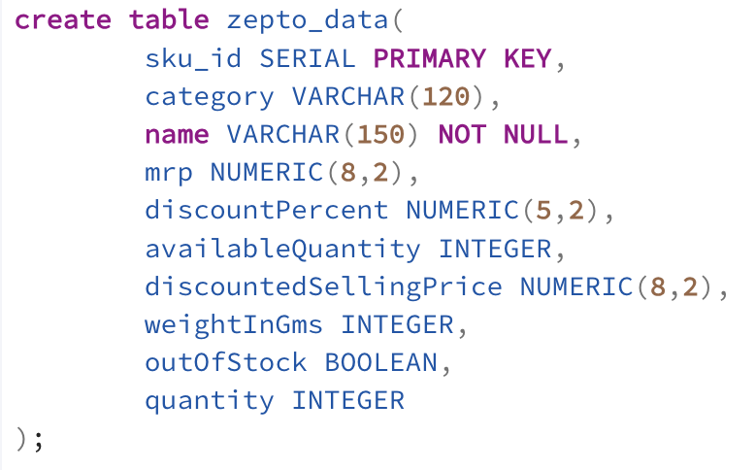
Creating a table named zepto_data
Column Name | Description
sku_id | Unique identifier for each product entry (Synthetic Primary Key)
name | Product name as listed on the Zepto app
category | Category of the product (e.g., Fruits, Snacks, Beverages)
mrp | Maximum Retail Price (originally in paise, converted to ₹)
discountPercent | Discount applied on MRP (in %)
discountedSellingPrice | Final price after discount (in ₹)
availableQuantity | Units available in inventory
weightInGms | Product weight in grams
outOfStock | Boolean flag indicating if the product is out of stock
quantity | Units per package (may be combined with weight for loose produce)

Slide 3
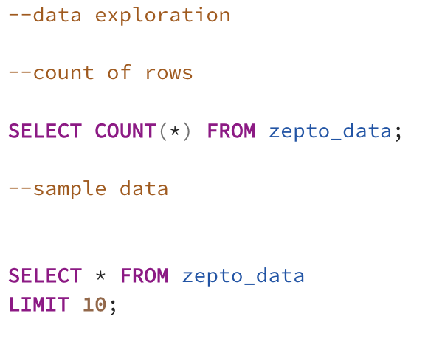
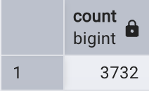
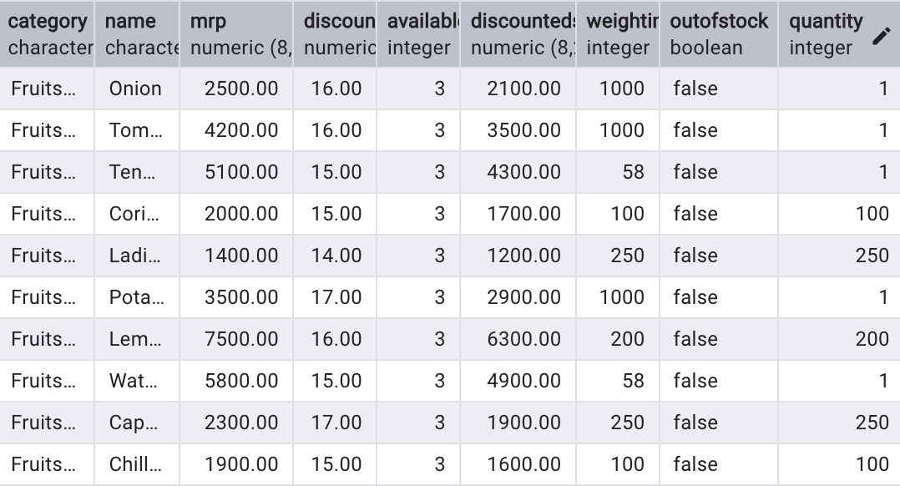
Data Exploration

Slide 4

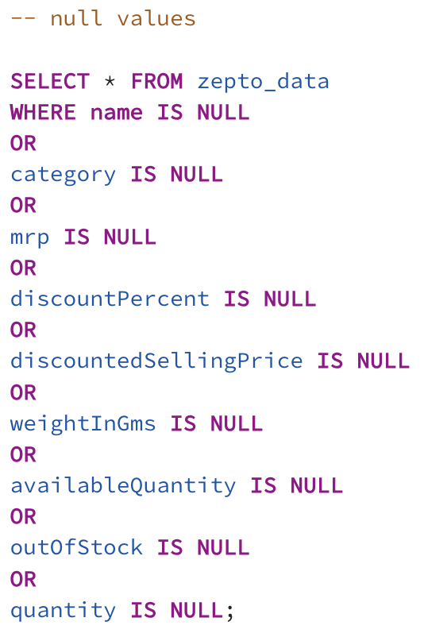
Find Null Values

Slide 5
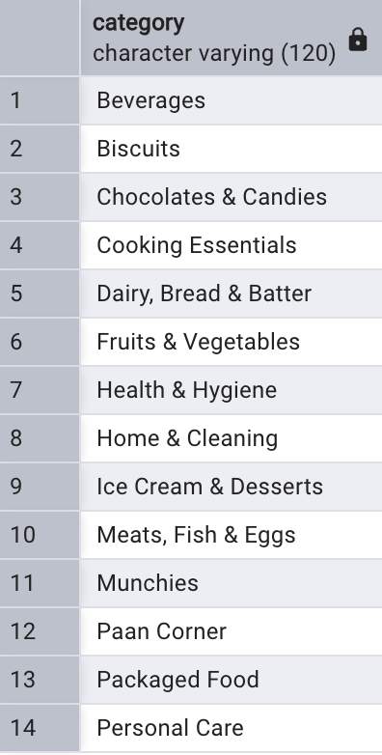
Distinct Product Categories

Slide 6
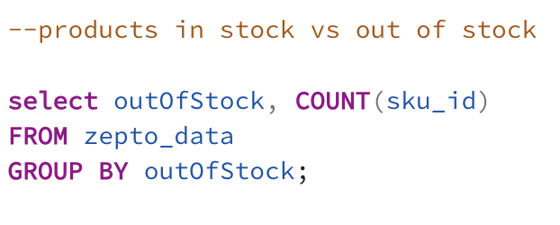
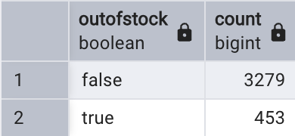
Products in stock vs out of stock

Slide 7
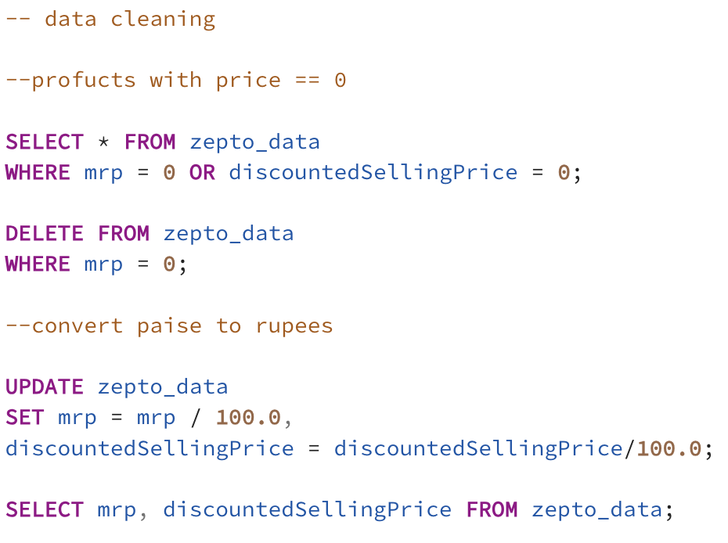
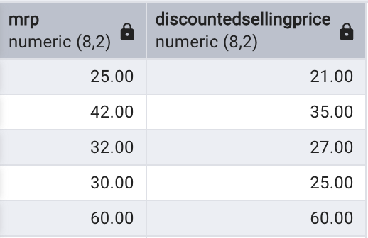
DATA CLEANING
DELETE PRODUCTS WITH PRICE ZERO.
CONVERT PAISE TO RUPEES.

Slide 8
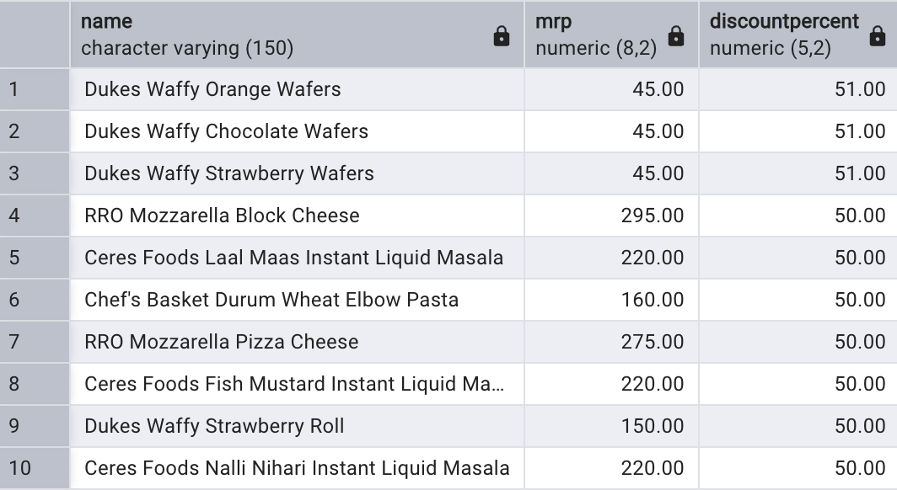
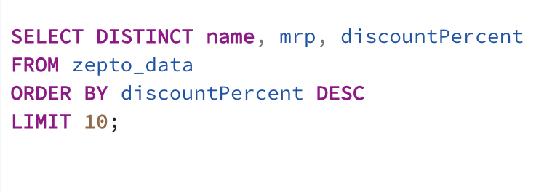
Q1. Find the top 10 best-value products based on the discount percentage.

Slide 9
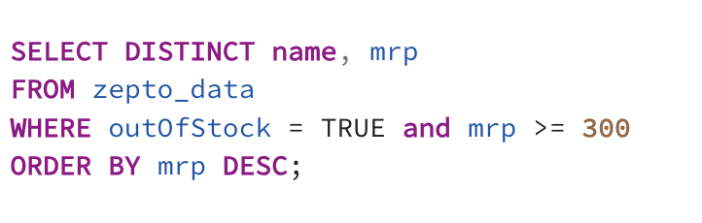
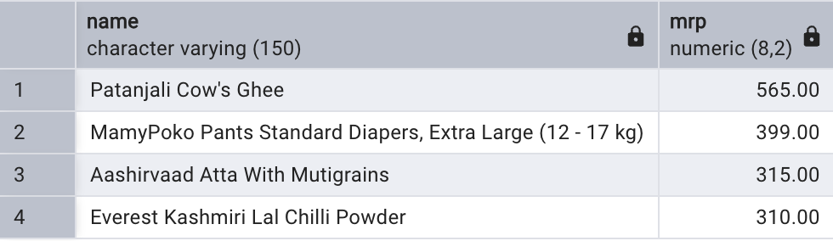
Q2. What are the products with High MRP but out of stock?

Slide 10
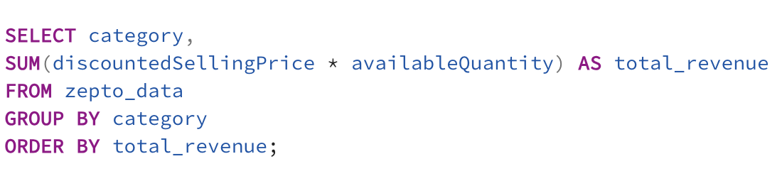
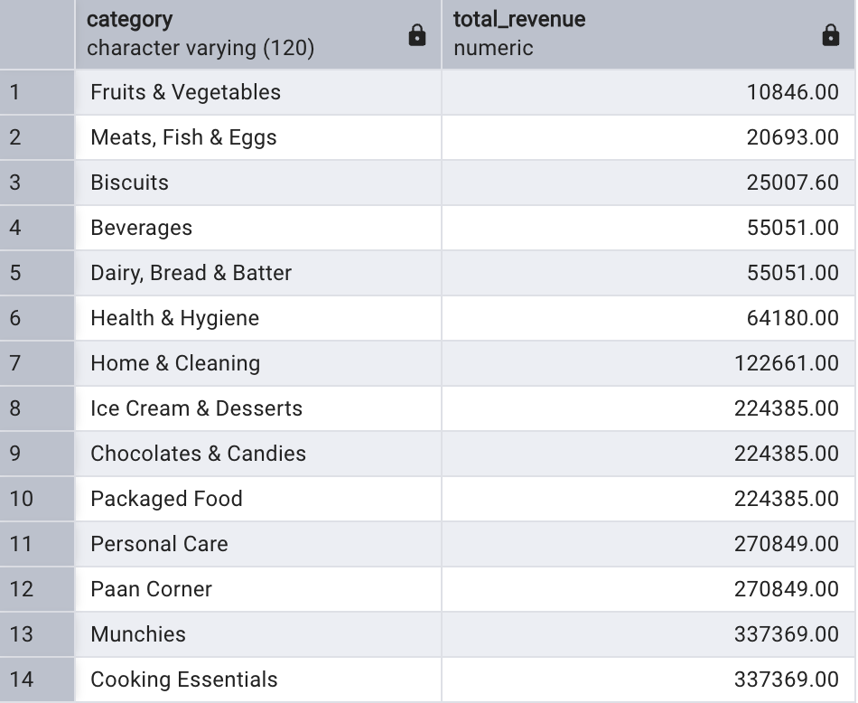
Q3. Calculate Estimated Revenue for each category.

Slide 11
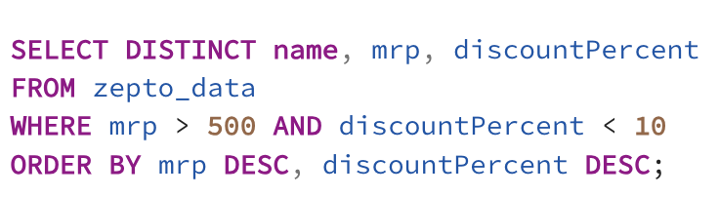
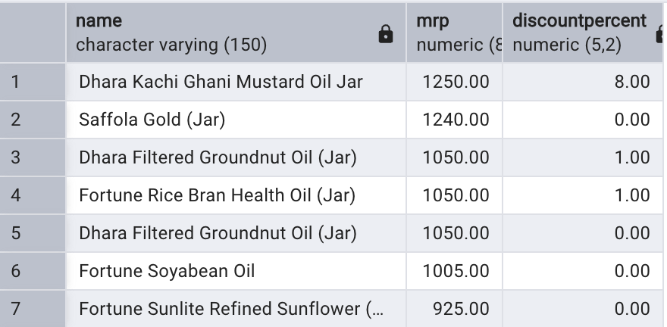
Q4. Find all the products where MRP is greater than Rs. 500 and discount is less than 10%.

Slide 12
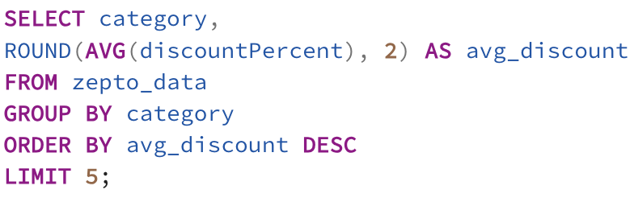
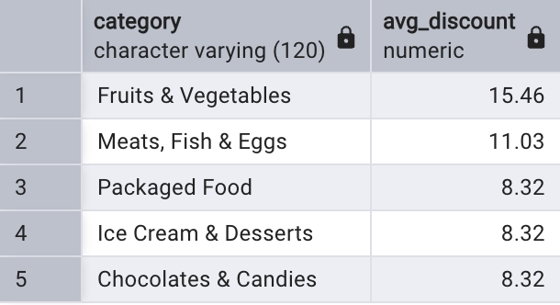
Q5. Identify the top 5 categories offering the highest average discount percentage.

Slide 13
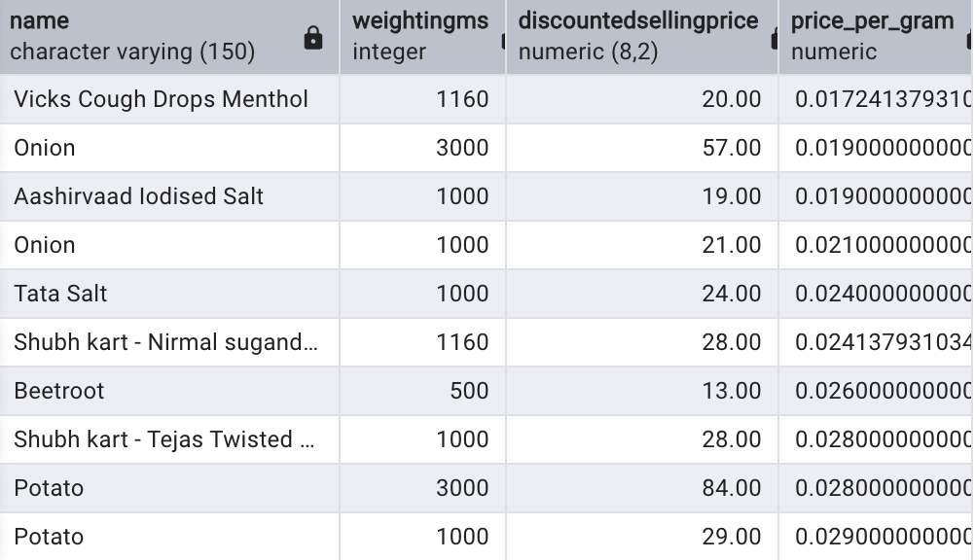
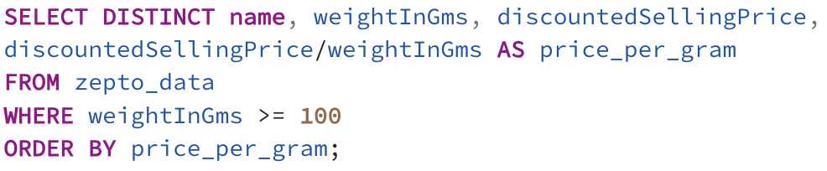
Q6. Find the price per gram for products above 100g and sort by best value.

Slide 14
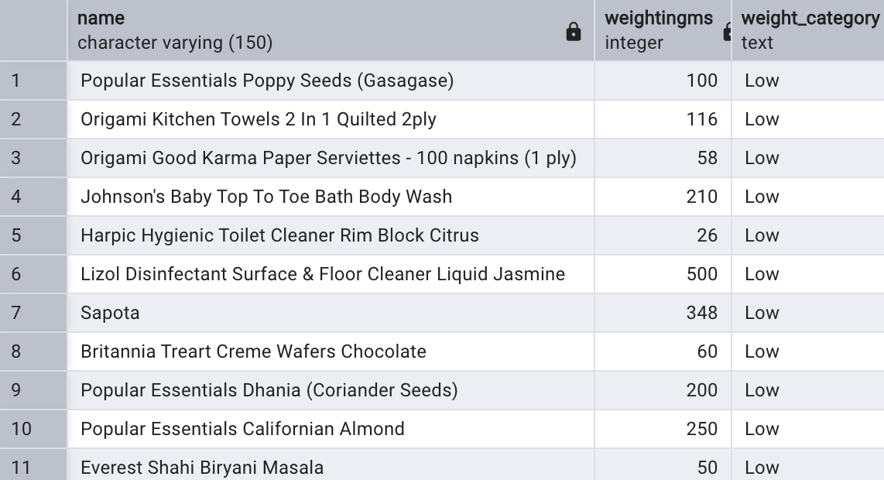
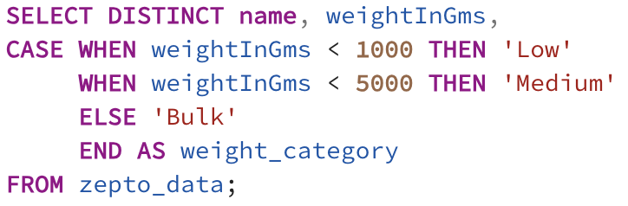
Q7. Group the products into categories: Low, Medium, Bulk.

Slide 15
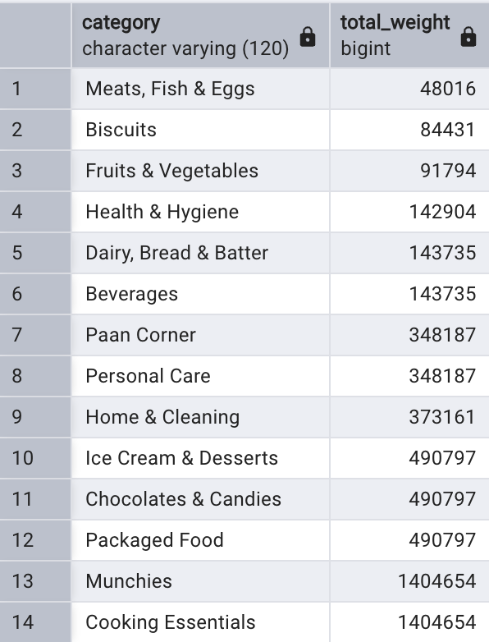
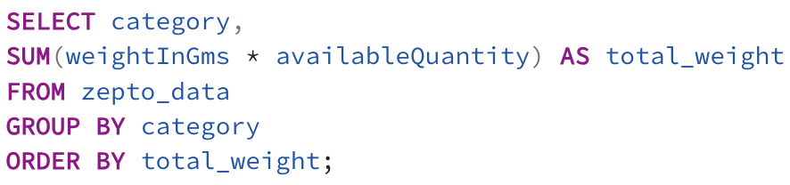
Q8. What is the total inventory Weight Per Category.

